Slide 1
LOGISTICS MANAGEMENT SYSTEM

Slide 2
TABLE OF CONTENTS
01
02
03
04
Objective
Problem statement
Proposed solution
05
UML diagram
conclusion

Slide 3
01
Project objective

Slide 4

Project Objective:
To develop a comprehensive logistics management system that enhances the efficiency and effectiveness of managing the movement and storage of goods within a supply chain.
GOALS:
Streamline logistics operations
Reduce operational costs.
Improve customer satisfaction

Slide 5
Order Management - Facilitates the management of customer orders from placement to fulfillment.
Features:
Captures and processes order details.
Tracks order status.
Integrates with other systems for accurate and timely order processing.
2. Transportation Planning and Execution - Enables efficient planning and execution of transportation activities.
Features:
Route optimization.
Carrier selection.
Load planning.
Scheduling.
3. Warehouse Management - Manages warehouse operations including inventory management, storage location optimization, and order fulfillment.
Features:
Inventory management.
Storage location optimization.
Order fulfillment.

Slide 6
4. Shipment Tracking and Visibility - Provides real-time visibility into the movement of goods.
Features:
Delivery status monitoring.
Enhances transparency.
Reduces shipment delays.
Improves customer service.
5. Supplier and Vendor Management - Manages supplier relationships and vendor performance.
Features:
Tracks supplier information.
Monitors vendor performance metrics.
Facilitates effective collaboration with suppliers.
Ensures timely and quality deliveries.
6. Reporting and Analytics - Offers reporting and analytics capabilities to provide insights into logistics performance.
Features:
Generates reports on key performance indicators (KPIs) such as transportation costs, on-time delivery, inventory levels, and warehouse productivity.
Helps identify areas for improvement.
Optimizes logistics processes.

Slide 7
02
Problem statement

Slide 8
Problem statement:
The objective of this project is to develop a state-of-the-art logistics management system that integrates all aspects of the supply chain, from order management to final delivery.
This system will streamline and optimize logistics processes, ensuring efficient transportation planning, warehouse management, and shipment tracking.
By providing real-time visibility and robust analytics, the system will enable businesses to make data-driven decisions, reduce operational costs, and enhance customer satisfaction.

Slide 9
03
Proposed system

Slide 10
Proposed Solution:
Integrated Logistics Platform
Real-Time Tracking and Visibility
Advanced Analytics and Reporting
Scalable and Customizable Architecture

Slide 11
04
UML diagram

Slide 12
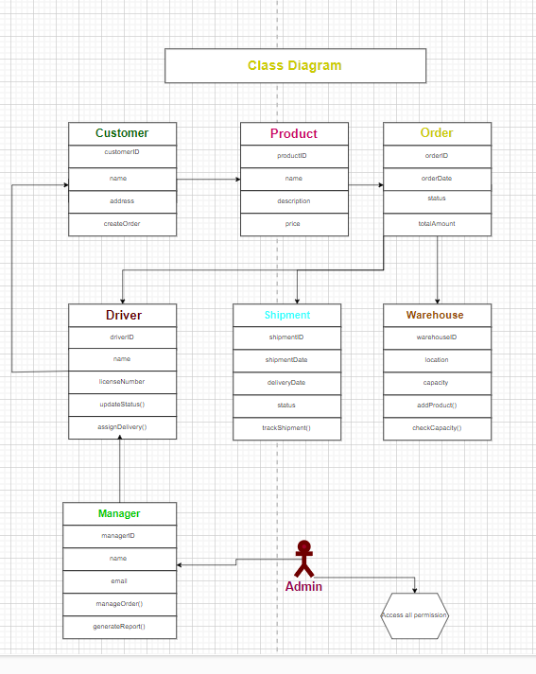
Class diagram:

Slide 13
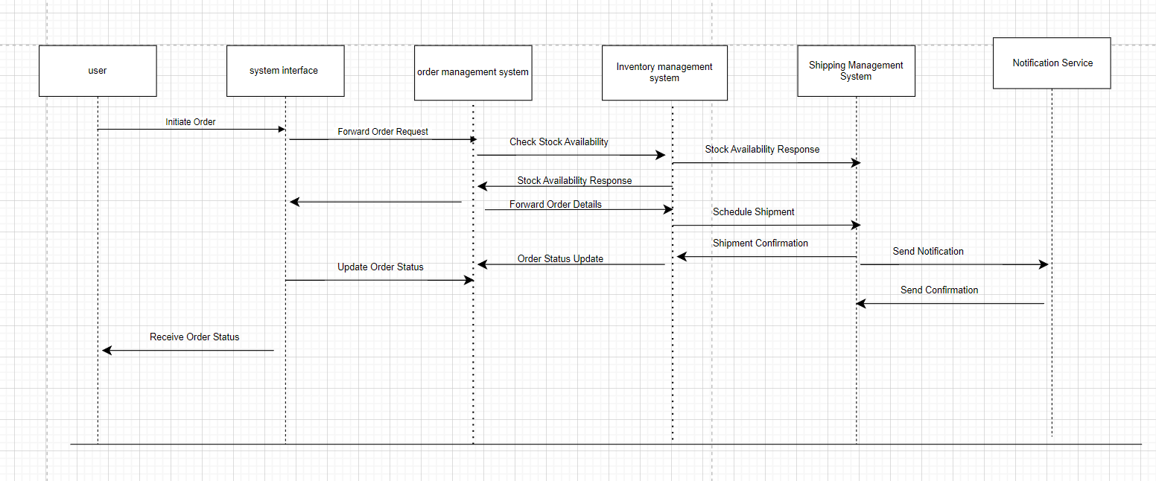
Sequence diagram:

Slide 14
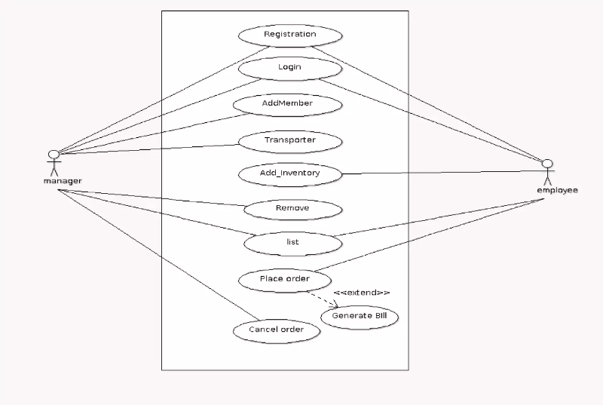
Use case diagram:

Slide 15
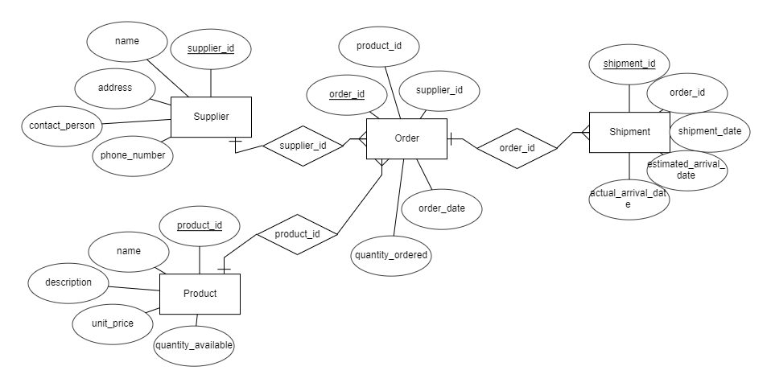
ER diagram:

Slide 16
05
conclusion

Slide 17
Conclusion:
A Logistics Management System (LMS) significantly enhances supply chain operations through several key benefits.
Firstly, it streamlines the entire order lifecycle from placement to fulfillment, ensuring accurate and timely processing while providing real-time tracking to improve customer satisfaction.
Secondly, it optimizes transportation planning and execution by efficiently planning routes, selecting carriers, and scheduling shipments, leading to reduced transportation costs and improved delivery times.

Slide 18


